Slide 1
Building Resilient Infrastructure and Communities
Cumberland County
2 August 2021
Notes:
The HMGP is a federal disaster assistance program administered in Pennsylvania by PEMA. The HMGP provides funding for certain types of “mitigation” projects that reduce or eliminate damages and losses due to natural disasters.

Slide 2


Agenda
BRIC and FMA Program purpose
Funding and Cost Share
Timelines
Project sub-application evaluation
FEMA GO system and application process
References and Resources

Slide 3
Building Resilient Infrastructure & Communities (BRIC)
BRIC Grant’s Intent:
Building Resilient Infrastructure and Communities (BRIC) will support states, local communities, tribes and territories as they undertake hazard mitigation projects, reducing the risks they face from disasters and natural hazards. BRIC is a new FEMA pre-disaster hazard mitigation program that replaces the existing Pre-Disaster Mitigation (PDM) program.
The BRIC program guiding principles are supporting communities through capability and capacity-building; encouraging and enabling innovation; promoting partnerships; enabling large projects; maintaining flexibility; and providing consistency

Slide 4
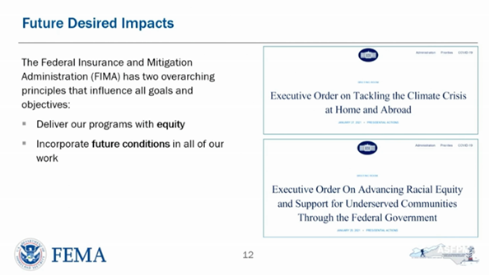
Future Conditions/DEI SJ & EJ

Slide 5
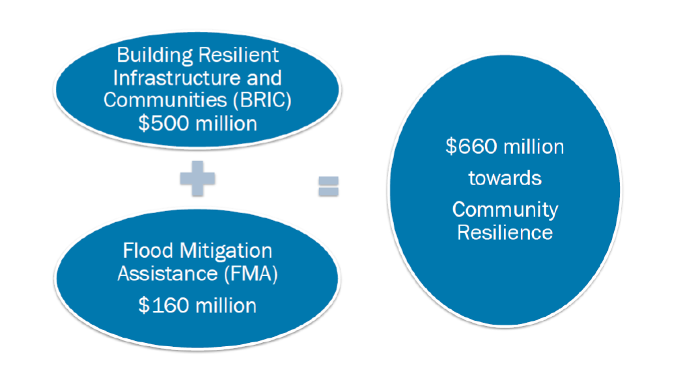
**FEMA Non-Disaster Mitigation Grants FFY 2020

Slide 6
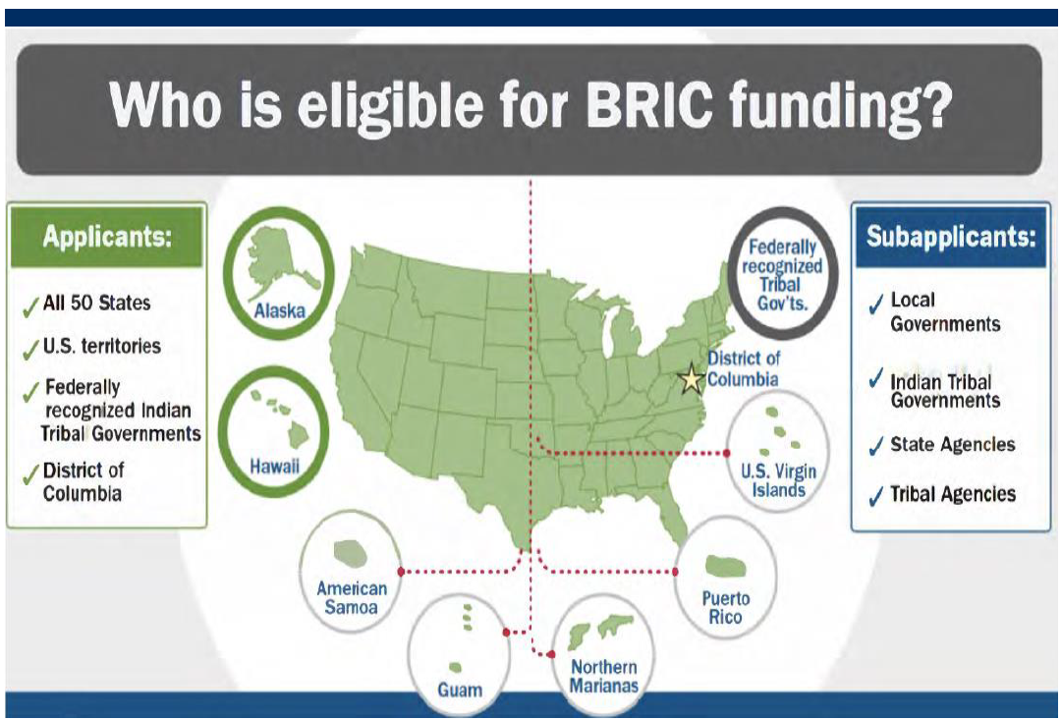
Building Resilient Infrastructure & Communities (BRIC)

Slide 7
What Did FEMA See this year?
Approximately 750 project subapplications (excluding non-competitive allocations) requesting….
$3.5 Billion in funding across BRIC and FMA in FY2020
……………..but, only…………….
$700 Million funding was available

Slide 8
Competitive vs Non-competitive funding
Most funding is competitive
Maximum $50 million in application per state
State set asides - BRIC
Each state can designate $600,000 worth of projects
Up to $300,000 for plans non-competitive
We normally need about $650,000 for plans each year
Up to $300,000 for projects non-competitive

Slide 9
FMA Funding
No set asides for non-competitive awards
$600,000 per Applicant for all Project Scoping subapps
$30 million cap per community flood mitigation project subapplication;
$100,000 per Applicant for flood hazard mitigation planning with maximums of:
$50,000 for state flood hazard mitigation planning;
$25,000 for local flood hazard mitigation planning;
5 percent of the total mitigation project for subapplicant management costs (local govt. labor)

Slide 10
BRIC 2021 will be $1 Billion
“Biden doubling FEMA funds for extreme weather preparations”
https://thehill.com/policy/energy-environment/555083-biden-doubling-fema-funds-for-extreme-weather-preparations
“The Biden administration will direct $1 billion toward the Federal Emergency Management Agency’s (FEMA) fund for extreme weather preparation, a 100 percent increase over existing funding levels…”
“The budget increase will go to the Building Resilient Infrastructure and Communities (BRIC) program…”

Slide 11

Cost Share Requirements
Generally, FEMA will pay 75% of all eligible costs
Building Resilient Infrastructure & Communities (BRIC)
FEMA will pay 90% for small impoverished communities
FEMA will pay up to 100% for management costs
Flood Mitigation Assistance
FEMA will pay up to 90% for Repetitive Loss Properties
FEMA will pay up to 100% for Severe Repetitive Lost Properties
Hazard Mitigation Grant Program (HMGP)
The State will usually pick up the 25% non-federal share
Require a Letter of Intent or Interest (on PEMA webpage)

Slide 12
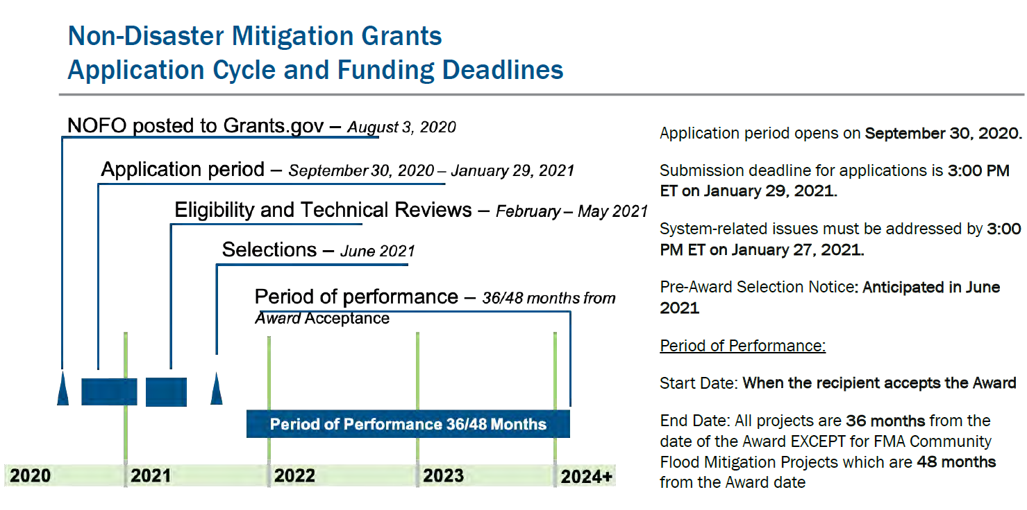
Non-Disaster FEDERAL GRANT TIMELINE
Grant Agreement Process
11

Slide 13
PA sub-application Timelines 2020
Deadlines:
Letter of Interest (one-pager) due by October 15, 2020, 1600 hours EST;
Entry into the FEMA Grants Opportunity once Letter of Interest is approved by PEMA;
Cut-off of Eligible and COMPLETE applications in the FEMA GO system is November 18, 1700 hours EST;
State Hazard Mitigation Assistance Application Team will meet December 7-18, 2020; and
Based on State Team points, prioritization of State Team and FEMA requirements, enter state FMA and BRIC applications in system by Saturday, January 15, 2021.
FEMA Deadline for all applications by state is January 29, 2021.
PEMA Letter of Interest found here:
https://www.pema.pa.gov/Mitigation/Grants-Projects/Non-Disaster-Forms/Pages/default.aspx Form 01 Non-Disaster Grant Letter of Interest

Slide 14
Detailed Timeline 2021 – 18 months
Aug 1, 2021 Notice Of Funding Opportunity (NOFO) released
Sept 30, 2021 Application period opens
Oct 15 2021 – LOIs due to PEMA
Nov 18, 2021 – Deadline for complete / correct sub-grant applications to PEMA
Jan 29, 2022 - Deadline for state grant applications to FEMA
April – June ~ish 2022 – Pre-award list released (who won)
October ~ ish 2022 – List of awardees published
December 2022– Actual FEMA award letter published- Federal funds obligated
Period of Performance (POP) Begins, runs for 36 months
PEMA Grants Management begins work on Grant Agreements
Jan – Mar 2023 - Sub-grantees conduct fiscal briefings with PEMA, work on Grant Agreement and supporting documents
April - May 2023 (completion of GA)– Sub-grantees can submit reimbursement requests to PEMA

Slide 15
Project Evaluation
Sub-applicant eligibility
Screening Criteria
PEMA priorities
Set asides
FEMA priorities

Slide 16
Sub-applicant eligibility
County must have an approved All Hazard Mitigation Plan.
Municipality must have participated and adopted the approved county plan.
Requested project funding must have been identified as a mitigation activity in the county plan
This year FEMA has demanded that non-governmental sub-applicant organizations had participated in the plan (water authorities)

Slide 17
Screening Criteria
Not all ideas are good ideas
Does it pass the FAS test?
Feasible – can it physically be done?
Acceptable – can we pay the cost / accept the risk?
Suitable – will it solve the problem?
Its it legal, allowed by regulations?
Is it within the scope of our organization?
Silver jackets
Benefit Cost Ratio greater than 1?
These should be weeded out with LOI (letter of intent)

Slide 18
PEMA priorities
Integrated with PA Hazard Mitigation Plan?
Address a high ranking hazard?
Goals, Objectives, Actions
County HM planning
SRL and RL properties
Acquisition, Elevation, Demo-rebuild
Project scoping
Projects integrated with DEP water quality
Social equity / distressed communities

Slide 19
HM Project Prioritization
Benefits Cost Analysis
Life saving vs property protection
Budget and maintenance costs
Substantial or repetitive loss
Project in Hazard Area? (floodplain)
Minority, impoverished or special needs populations
Environmental or cultural benefits (sense of place)
Quality of application
Past project management performance
DR Mitigation strategy priority

Slide 20
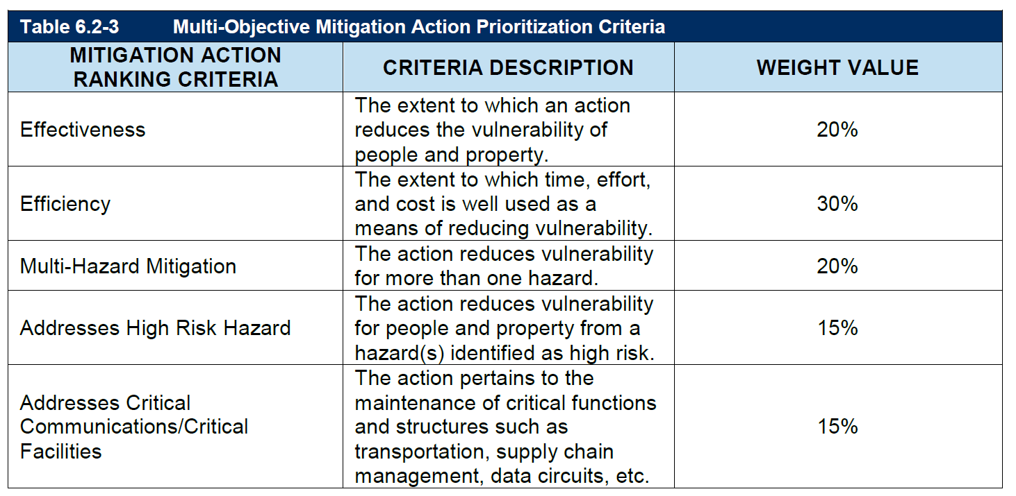
State Mitigation Planning Team Actions Criteria
HM State Goals updated in 2018 and covers 129 mitigation actions
19
Notes:
2018 PDM 235k, 2019 PDM, 250k, BRIC 500k
2018 FMA 160k, 2019 FMA 210k, 2020 160k

Slide 21
FEMA priorities
FMA
Flood Control Projects
Watershed and Wetlands restoration
Stormwater management
Flood water retention, detention and diversion
NOT for acquisition or elevation in 2020
BRIC
Acquisition Demolition / Elevation / Demo-rebuild of SRL / RL
Planning
Scoping
Building Codes
Resiliency
Environmental Justice and Social Equity

Slide 22
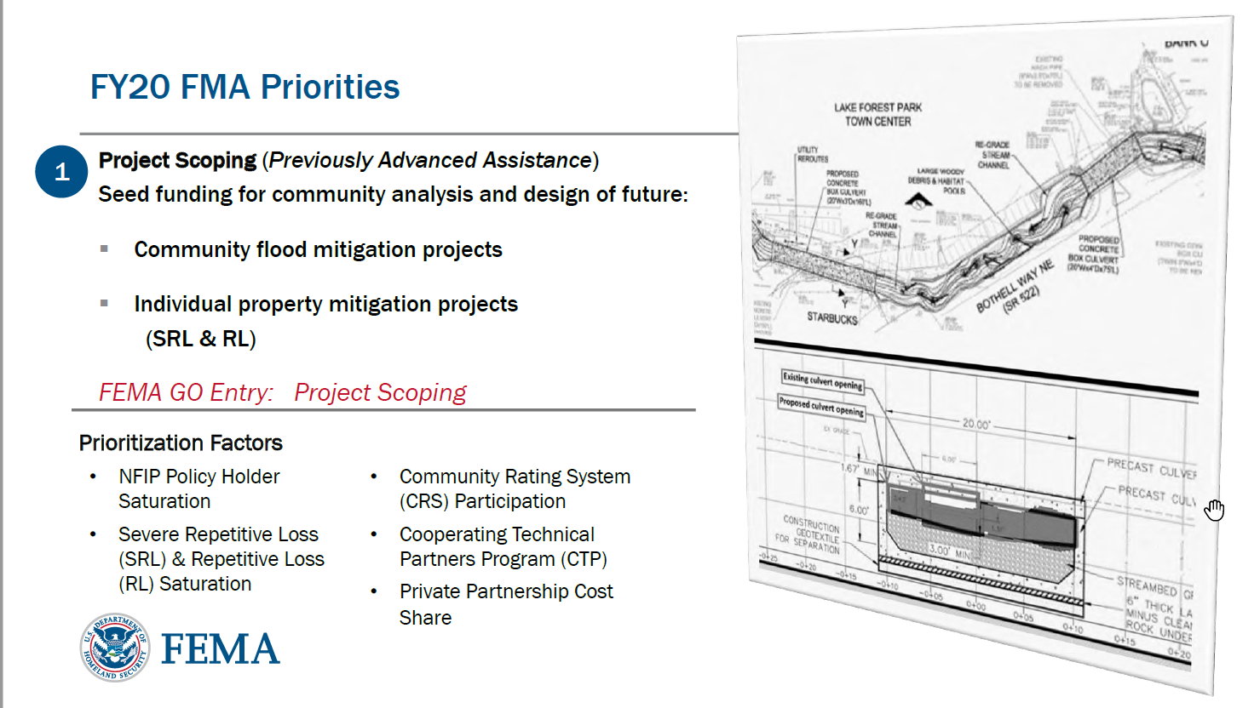
FMA 2020 Priorities

Slide 23
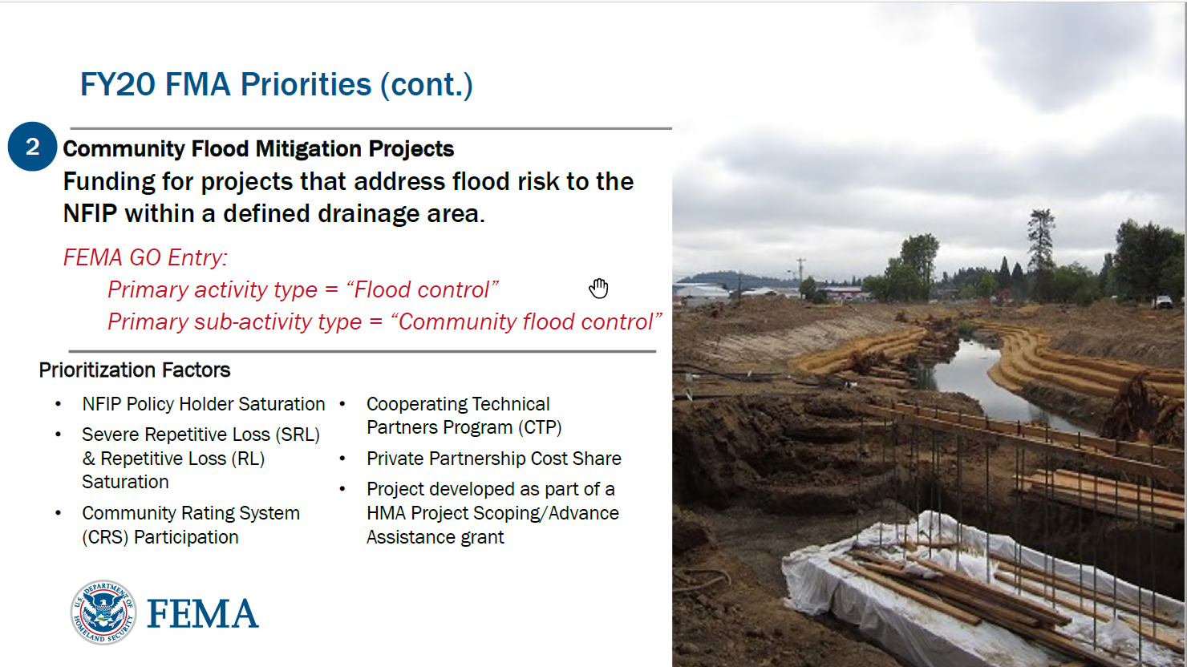
FMA 2020 Priorities

Slide 24
BRIC 2020 Project Scoring
2) Technical Scoring (Each category is ALL or NONE for points)
- Infrastructure Project – 20 points
- Mitigating risk to one or more lifelines – 15 points
- Incorporation of nature-based solutions – 10 points
- Applicant has mandatory building code (2015 or 2018 versions of IBC and IRC) – 25 points
- Sub-applicant has Building Code Effectiveness Grading Schedule Rating of 1 to 5 – 15 points
- Application generated from a previous FEMA HMA Advance Assistance Award – 10 points
- Increased non-federal cost share – 5 points
- Designation as a small impoverished community – 5 points
3) Qualitative Scoring (Peer Review Team) Each Category is 1-35, 1-15 or 1-5 available points
- Risk Reduction/Resiliency Effectiveness 35 points
- Future Conditions – 15 points
- Implementation Measures – 15 points
- Population Impacted – 15 points
- Outreach Activities – 5 points
- Leveraging Partners – 5 points

Slide 25
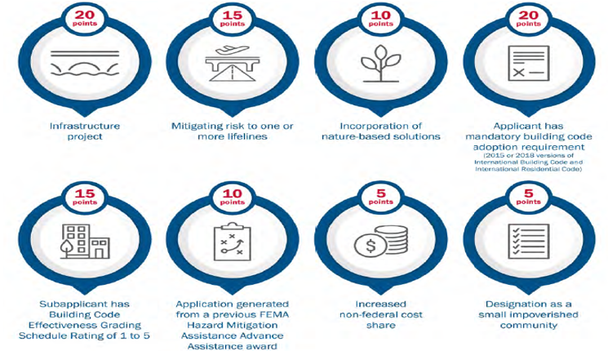
BRIC – Technical Criteria (100 points)
ALL OR NONE!

Slide 26
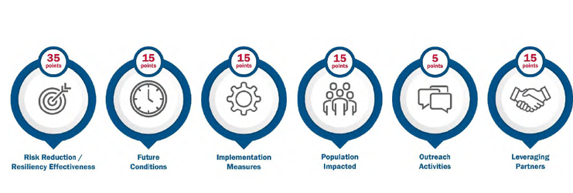
BRIC – Qualitative Criteria
Note: Can Pick up points in each category, not all or none like the Technical Criteria – However, was in increments during this year’s review panel

Slide 27
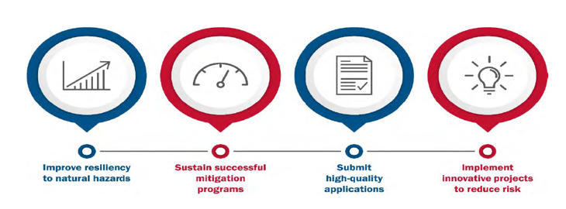
BRIC – Direct Technical Assistance
Non-Financial Direct Technical Assistance will be provided to up to 10 selected communities o support the mitigation outcomes listed below:

Slide 28
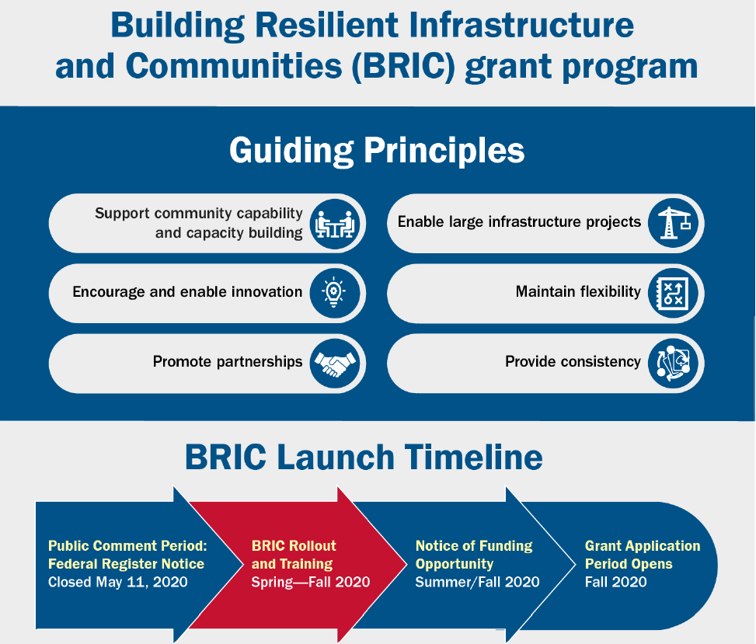
BRIC Guiding Principles
Support’s FEMA’s Strategic Plan
Build a Culture of Preparedness
Ready the Nation for Catastrophic Disasters
Reduce the Complexity of FEMA
27

Slide 29
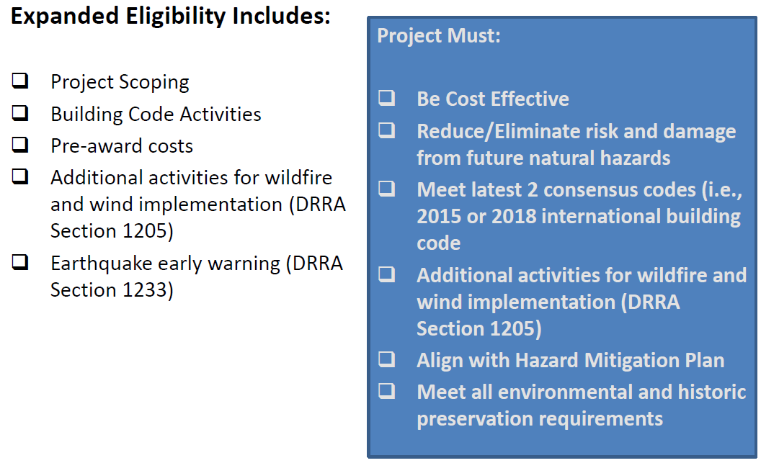
BRIC Eligible Activities

Slide 30
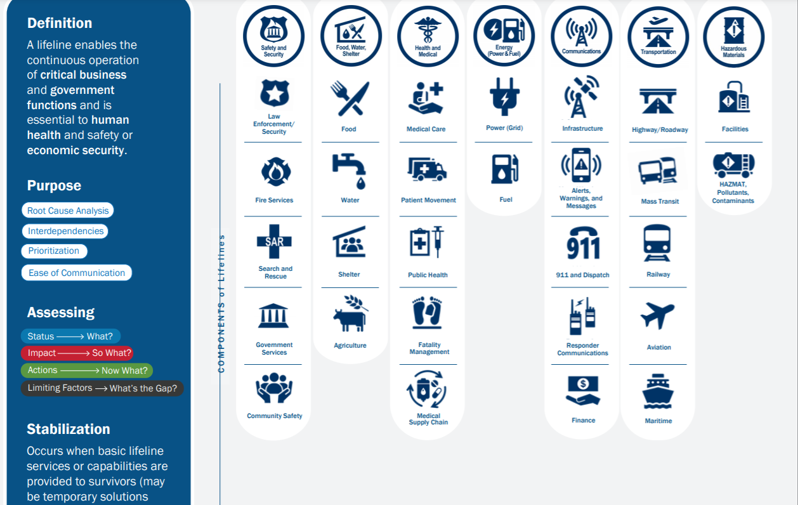
FEMA Community Lifelines

Slide 31
FEMA Grants Outcomes (FEMAGO)
FEMAGO has replaced EGRANTS
FEMAGO is an even bigger PITA than E-grants was.
You will need a DUNS number that is the exact match for your organization
Figure out FEMAGO and get account now . It can takes months.
Need to find SAMs account: System of Awards Management
Someone in your town has account. Probably a finance person
Needs EIN number from SAMS
You will need SAMS account holder to go in to FEMAGO and designate you as authorized representative

Slide 32
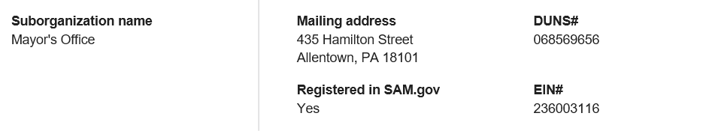
DUNS and EIN must corelate!!!

Slide 33
HOW TO APPLY/FEMA GO
FEMA Program Website:
FMA- https://www.fema.gov/grants/mitigation/floods
BRIC- www.fema.gov/bric
FEMA GO Helplines:
femago@fema.dhs.gov
1-877-611-4700
BCA Helpline:
BCHelpline@fema.dhs.gov
1-855-540-6744
Feasibility and Effectiveness Helpline:
FEMA-BuildingScienceHelp@fema.dhs.gov
Environmental and Historic Preservation:
EHPHelpline@fema.dhs.gov
1-866-222-3580
HMA Helpline:
HMAGrantsHelpline@fema.dhs.gov
1-866-222-3580
FEMA Region III
Non-Disaster HMA Team
Dustin Brosius - HMA Branch Chief
Angel Gillette – Non-Disaster HMA Team Lead
Crystal Newman – Pennsylvania
Manan Vyas – Civil Eng. Team Lead
32

Slide 34
How to Apply –
Start with County to PEMA / FEMA and work your way outward
LOI – Letter OF Intent
Email to Tom Hughes
One page – what you want to do
PEMA will let you know if it is something we fund or if not, who might
If it looks good – FEMA GO
https://go.fema.gov/ more fun that E-Grants ☹
Other agencies and organizations will have their own systems
All are long slow painful
Do not expect fast money
BRIC / FMA 18 months
HMGP 6 -12 months

Slide 35
Contact Information
Tom Hughes, State Hazard Mitigation Officer
(717) 651-2726 or thughes@pa.gov
Julie Yu, Non-Disaster Project Officer
(717) 651-2279 or juyu@pa.gov
PEMA WEBSITE: http://www.pema.pa.gov
PEMA, 1310 Elmerton Avenue, Harrisburg PA 17110
Our best advice is to email your scanned Letters of Interest (LOI) directly to Julie Yu at juyu@pa.gov
PEMA Fax# is: 717-651-2150
Resource Account
RA-Shazmitoff@pa.gov

Slide 36
References and Resources

Slide 37
FEMAGO
Visit FEMA GO Guides and Resources to view the technical
user manuals and support materials.
For FEMA GO Technical Support, contact the Help Desk by calling 1 877-611-4700 or by email at: femago@fema.dhs.gov.

Slide 38
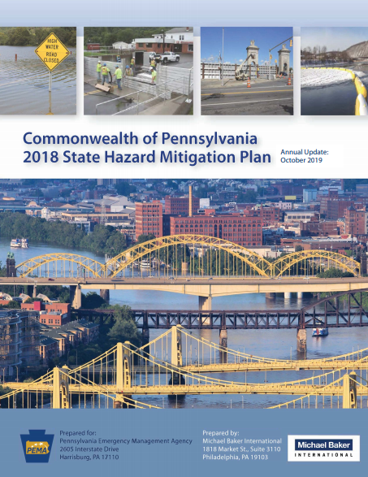
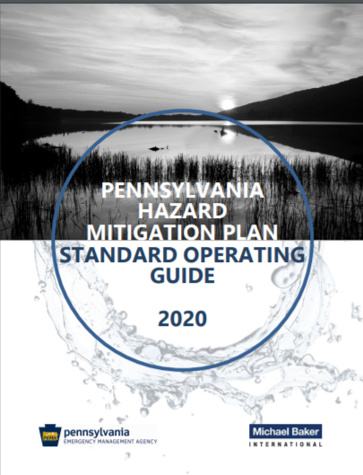
Hazard Mitigation
https://pahmp.com/wp-content/uploads/2020/07/PA-HMP-Standard-Operating-Guide_2020.pdf
https://pahmp.com/2020/01/10/3428/
Notes:
This is a continuous cycle that is monitored by our Federal Emergency Management Agency (FEMA) partners in the Region III office. PEMA’s Bureau of Recovery and Mitigation’s Hazard Mitigation Division provides 2 different Hazard Mitigation Planning training courses to County Emergency Management and County Planning offices that cast a wide net of municipal, county and association stakeholders in the update process. The county plans must meet FEMA approval and then must be adopted by each municipality within the county. Failure to do so could cost federal recovery and mitigation funding opportunities, especially before, during and after a disaster. All 67 counties and 14 PASHHE universities have completed this process and continue to update their plans so they are in a position receive these mitigation and resiliency dollars.

Slide 39


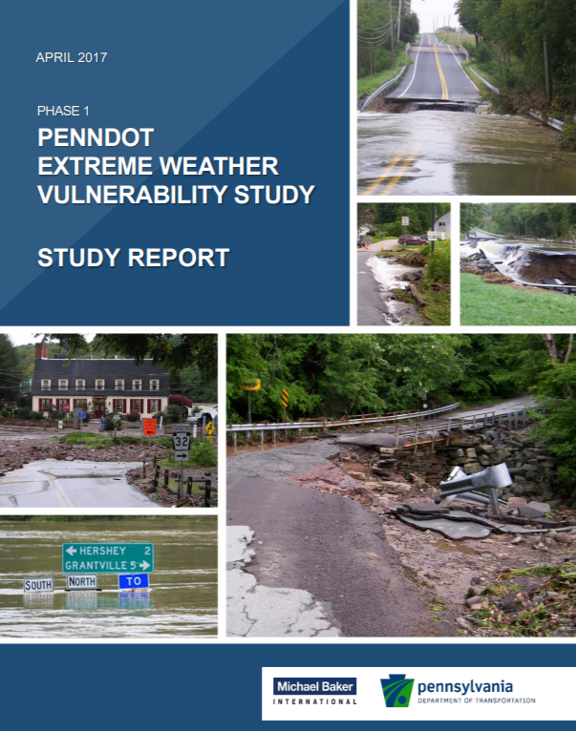
Climate Adaptation/Future Conditions
https://www.dep.pa.gov/Citizens/climate/Pages/PA-Climate-Action-Plan.aspx
http://elibrary.dcnr.pa.gov/GetDocument?docId=1743769&DocName=Climate_Change_Adaptation_Plan_Final_Aug2018.pdf
http://s3.amazonaws.com/tmp-map/climate/doc/StudyReport-PaVulnerabilityStudy-ver040317.pdf
Notes:
PEMA has worked with several agencies to ensure that Future Conditions are identified in the State and County plans per the 44 CFR.

Slide 40
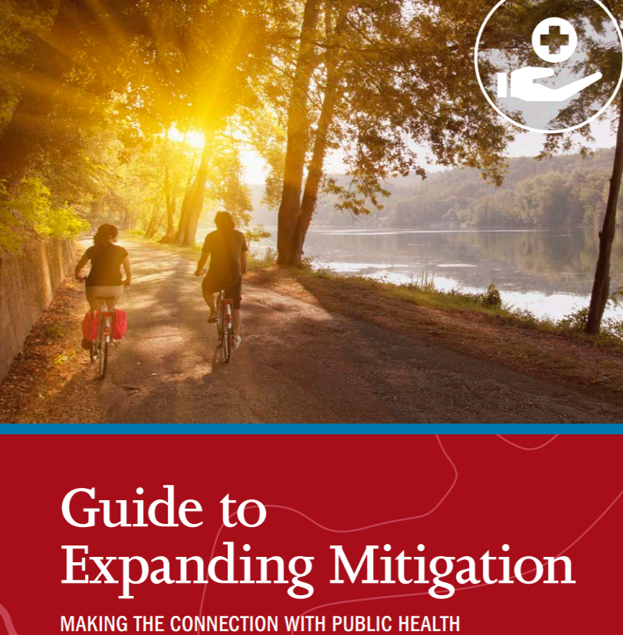

Guides to Expanding Mitigation
39
Notes:
Connecting Mitigation and Electric Power
Connecting Mitigation and Equity
Connecting Mitigation and Municipal Financing
Connecting Mitigation and Transportation
Connecting Mitigation and Public Health
Connecting Mitigation and Agriculture
Connecting Mitigation and Arts and Culture

Slide 41
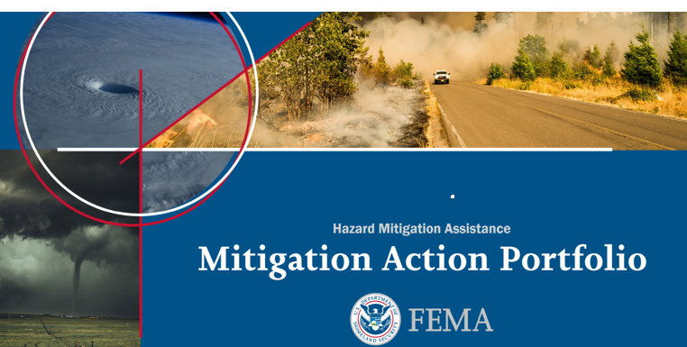
Mitigation Action Portfolio
https://www.fema.gov/sites/default/files/2020-08/fema_mitigation-action-portfolio-support-document_08-01-2020_0.pdf 107 Pages!
40

Slide 42
Mitigation Success Stories Factsheets
Notes:
Open document; Tom walks through examples

Slide 43

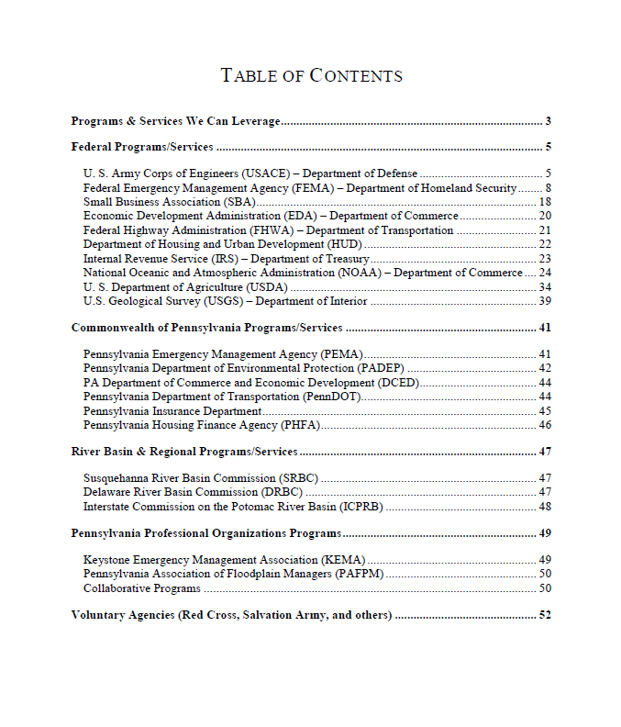
PA SJ Interagency Flood Mitigation Program Guide
PA SJ Team developed a document that lists and describes many of the federal, state, and local flood related assistance programs available in PA
Developed in 2011, updated in 2015
Notes:
This has been shared extensively with PA counties and municipalities and many other State teams for use. Recently Philly representatives briefed the SJ team and said how useful the product was.

Slide 44
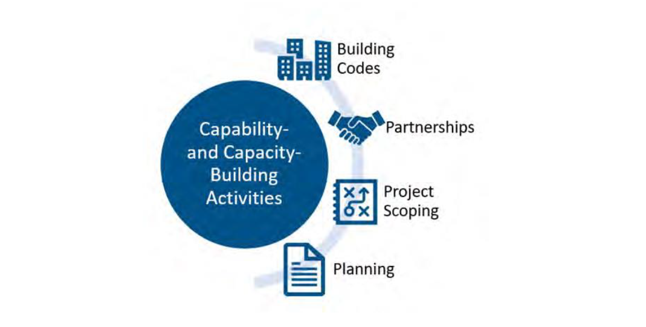
BRIC Capability- and Capacity-Building Activities

Slide 45
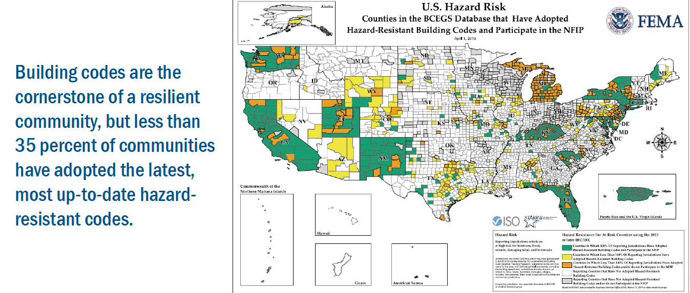
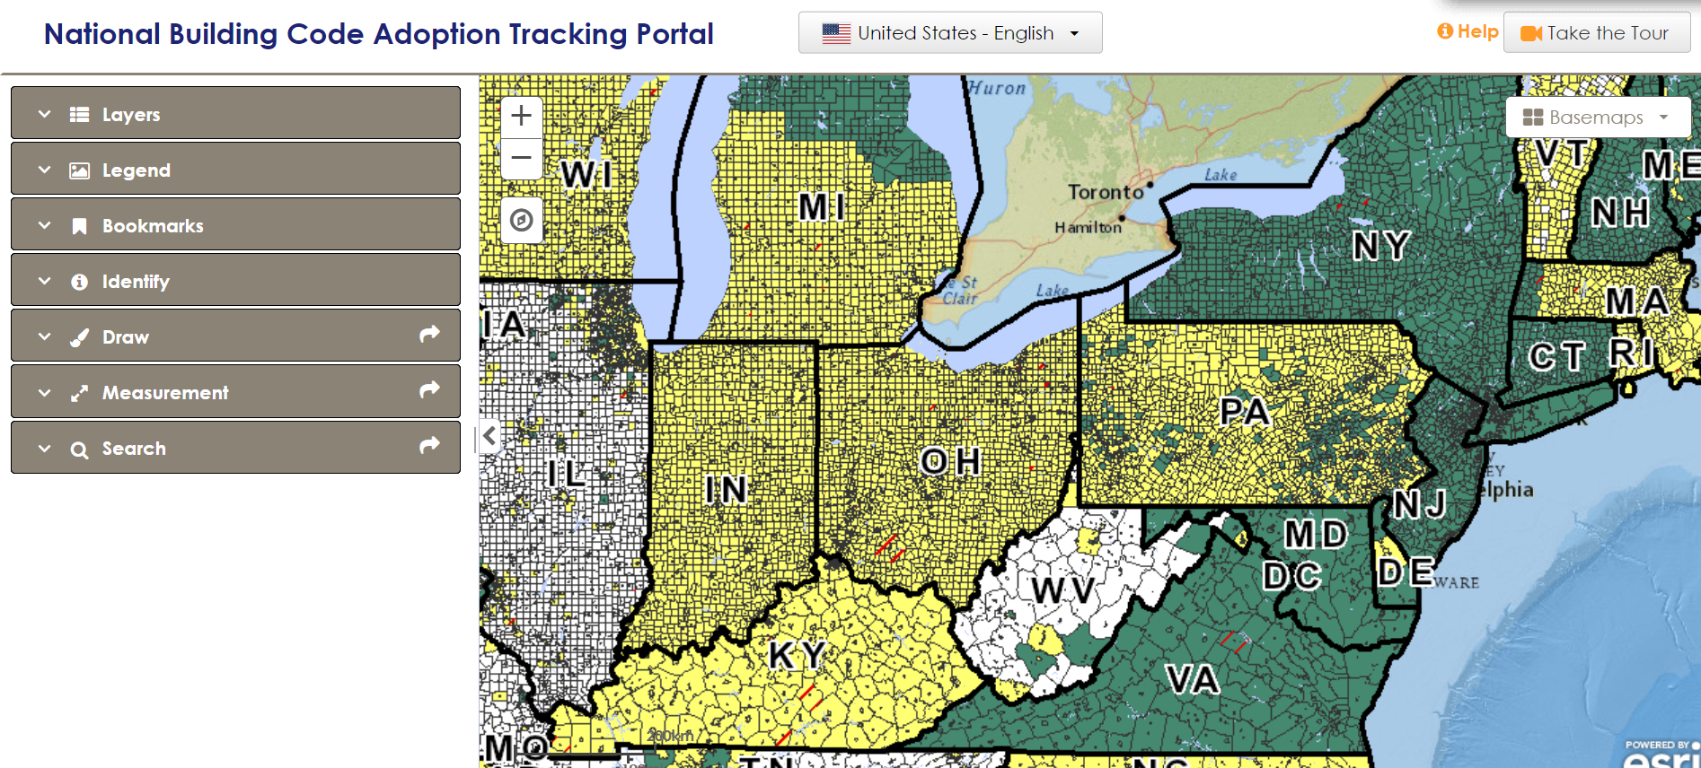
Local Building Codes and Enforcement
One way to check as a quick reference guide regarding local Mandatory building code adoption is to check out this online portal at: https://geo.stantec.com/National_BCATS_Portal/viewer/
Notes:
This is just a map to gain situational awareness on your community or communities that you may do business with. Found this portal very useful as it drills down to the lowest-level of land-use decision.

Slide 46
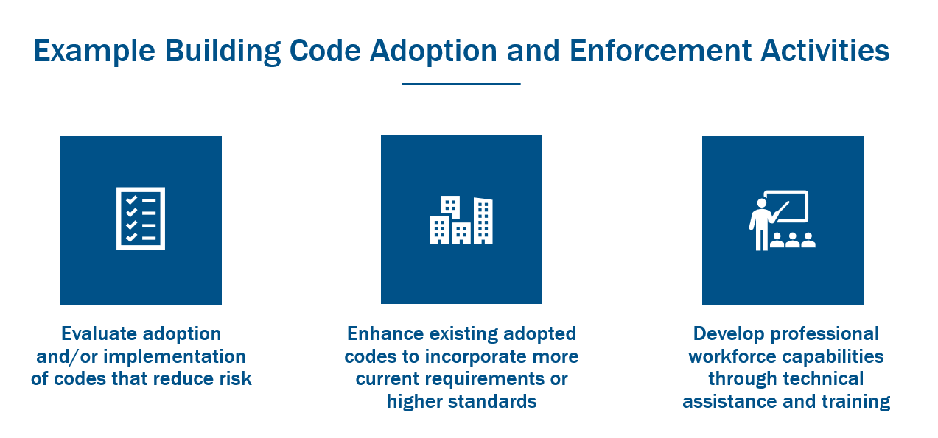
BRIC Capability- and Capacity-Building Activities
45

Slide 47
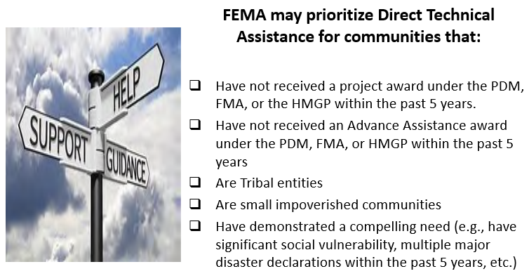
BRIC – Direct Technical Assistance

Slide 48
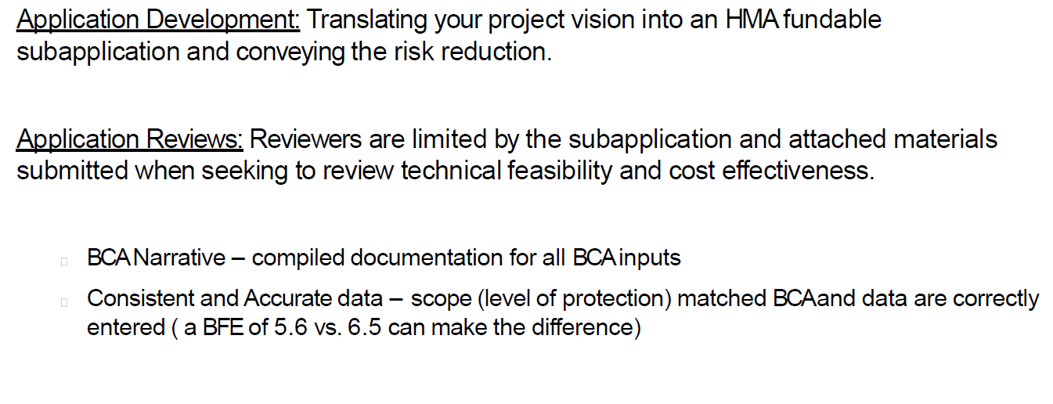
Challenges for Locals

Slide 49
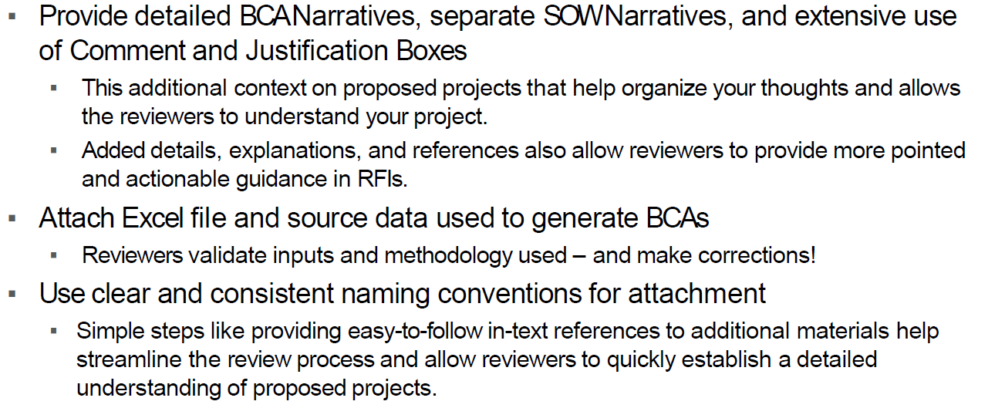
General Best Practices

Slide 50
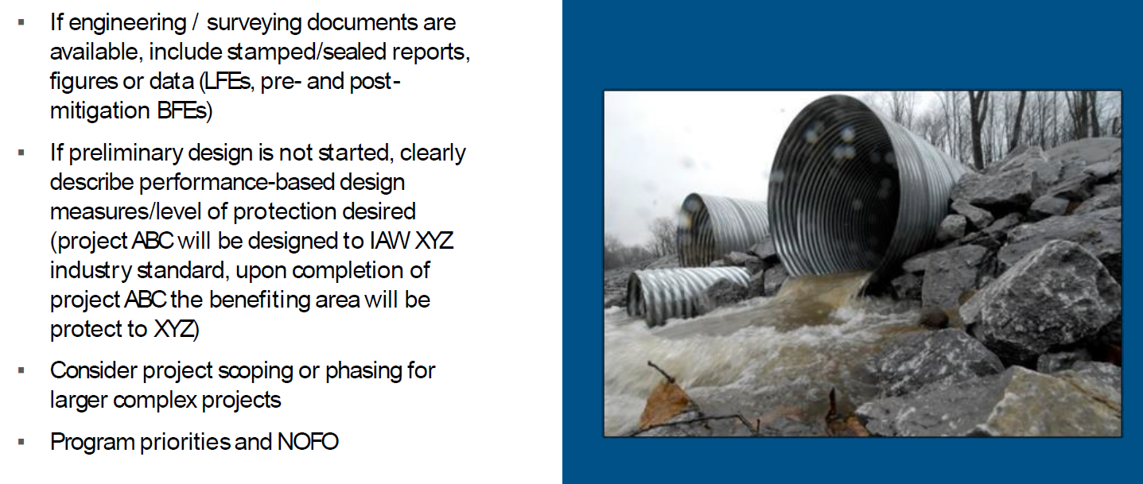
Additional Best Practices

Slide 51
Guides to Expanding Mitigation
https://www.fema.gov/about/organization/region-2/guides-expanding-mitigation 7 Guides that are out on the FEMA Region 2 page **NEW
Connecting Mitigation & Electric Power
Connecting Mitigation & Equity
Connecting Mitigation & Municipal Financing
Connecting Mitigation & Transportation
Connecting Mitigation & Public Health
Connecting Mitigation & Agriculture
Connecting Mitigation & Arts and Culture
50
Notes:
Connecting Mitigation and Electric Power
Connecting Mitigation and Equity
Connecting Mitigation and Municipal Financing
Connecting Mitigation and Transportation
Connecting Mitigation and Public Health
Connecting Mitigation and Agriculture
Connecting Mitigation and Arts and Culture

Slide 52
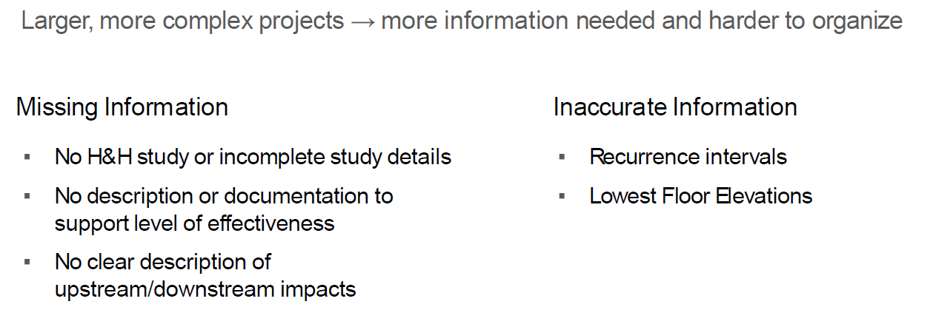
Infrastructure Projects – Common Challenges

Slide 53
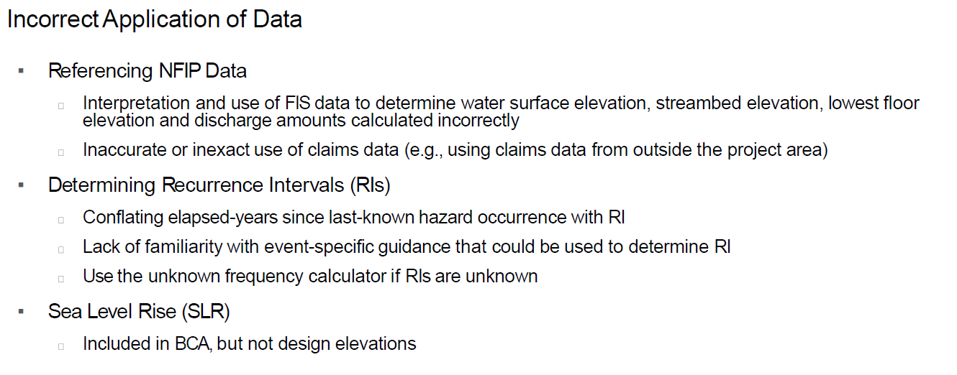
Infrastructure Projects – Reviewer Notes

Slide 54
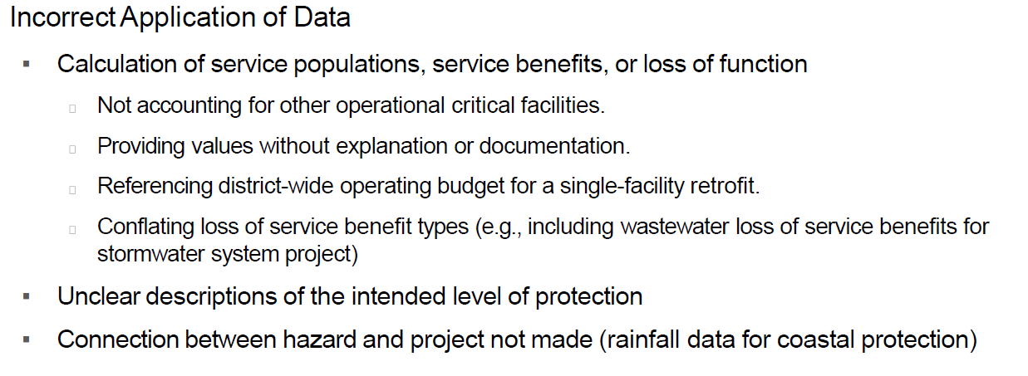
Infrastructure Projects – Reviewer Notes (cont)

Slide 55
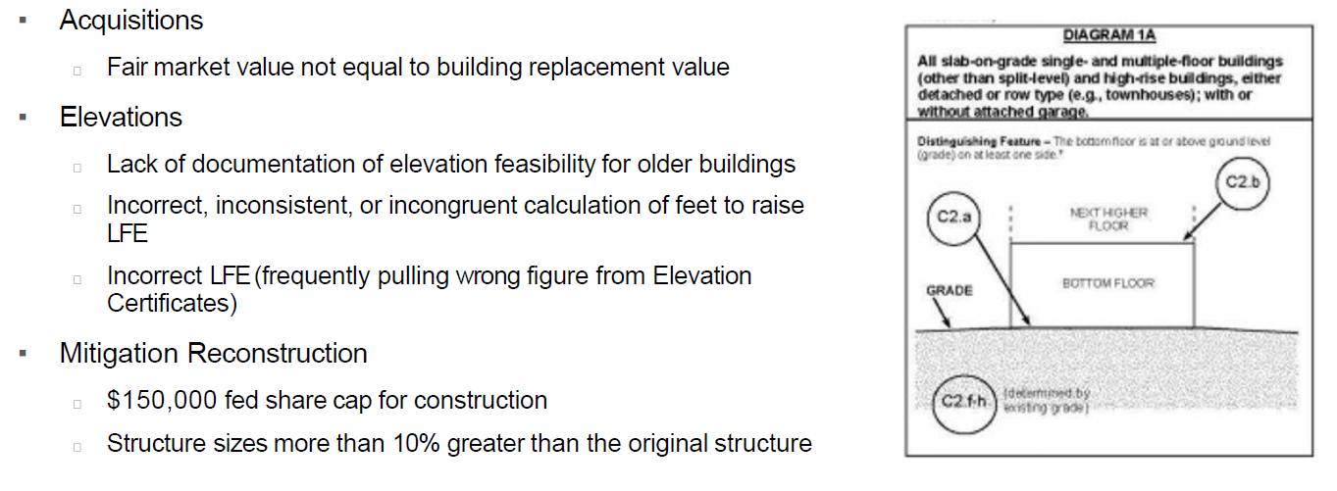
Acquisition, Elevation & Mitigation Reconstruction
BCA & Technical Feasibility Challenges

Slide 56
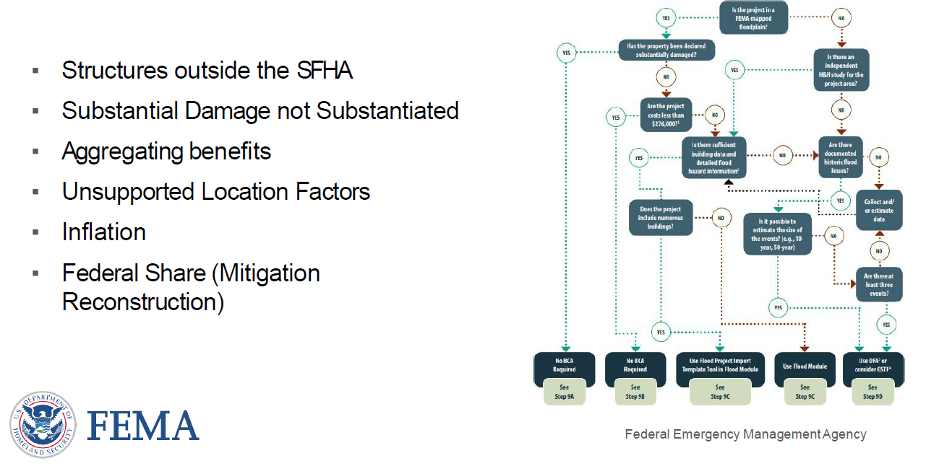
Acquisition, Elevation & Mitigation Reconstruction
Precalculated Benefit Challenges

Slide 57
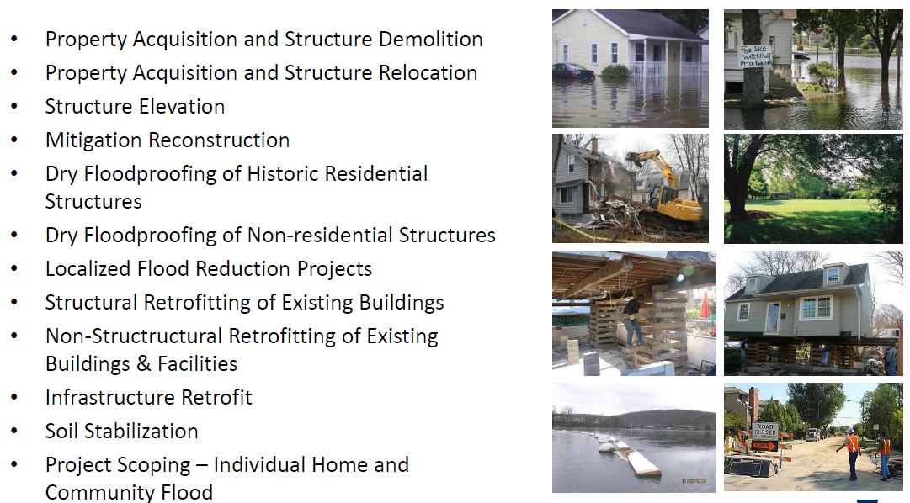
FEMA Eligible Projects under FMA

Slide 58
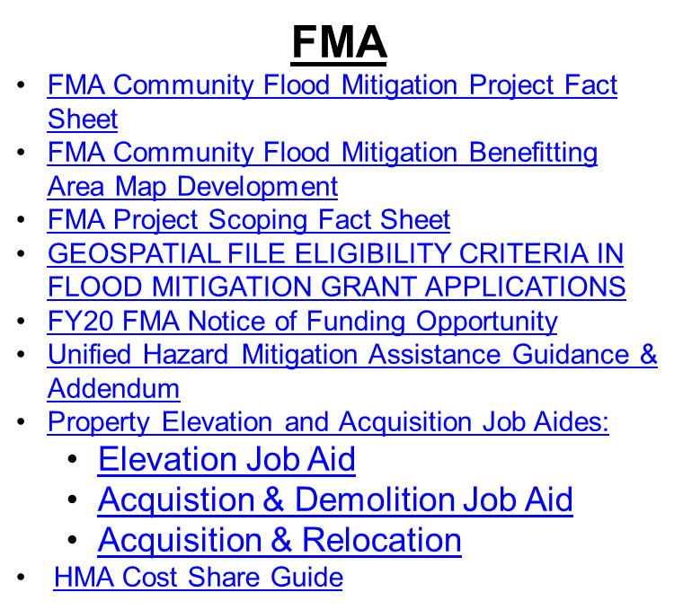
Program Support Material
BRIC
Mitigation Action Portfolio
BRIC Building Codes Activities
BRIC Partnership Activities
BRIC Project Scoping Activities
BRIC Mitigation Planning Activities
BRIC Direct Technical Assistance
BRIC Technical Criteria
BRIC Qualitative Criteria
HMA Cost Share Guide
FY20 BRIC Notice of Funding Opportunity

Slide 59
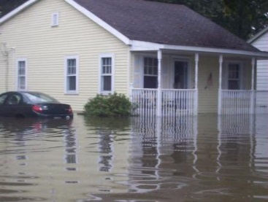
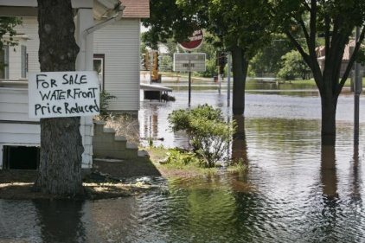
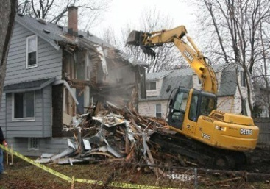

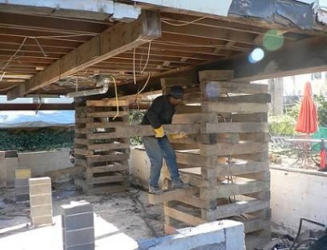
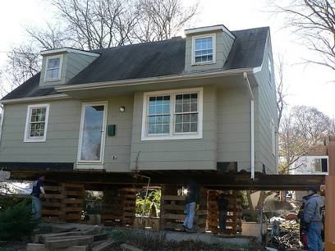
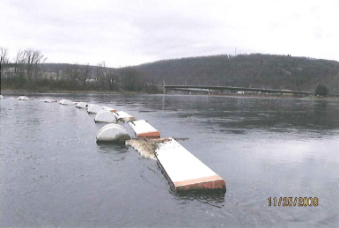
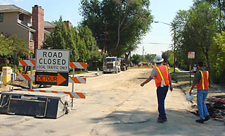
Eligible HMGP Projects
Property Acquisition and Structure Demolition
Property Acquisition and Structure Relocation
Structure Elevation
Mitigation Reconstruction
Dry Floodproofing of Historic Residential Structures
Dry Floodproofing of Non‐residential Structures
Localized Flood Reduction Projects
Structural Retrofitting of Existing Buildings
Non-Structural Retrofitting of Existing Buildings & Facilities
Infrastructure Retrofit
Soil Stabilization
Project Scoping – Individual Home and Community Flood
5% Mitigation Projects (State Initiative)
7% Hazard Mitigation Planning

Slide 60
2013 FEMA Cost-Effectiveness Policy
For properties in the 100-year floodplain
Acquisitions, if cost is $276,000 or less*
Elevations, if cost is $175,000 or less*:
The project is considered cost-effective and no further Benefit-Cost Analysis (BCA) is required.
For all other project types or properties that do not meet thresholds above, BCA is required
*(average cost per property in the project)
Notes:
As of August 15, 2013 FEMA has established a new cost-effectiveness policy for acquisition or elevations projects.
For properties in the 100-year floodplain only. For acquisition projects, if the total project cost is $276,000 or less per property or for elevation projects if the total project cost is $175,000 or less per property, the project is considered cost-effective and no further Benefit-Cost Analysis (BCA) is required.
For projects with more than one structure, the same policy applies based on the average cost per structure.
For all other project types or properties that do not meet the benefit thresholds above, a BCA is required.

Slide 61
Does your project fit?
Thinking globally……. does it fit locally?
Climate change, environmental protection etc
Who is going to pay for it and what is their organization’s mission?
How does it fit within the larger area such as watershed plans?
Is it integrated with other plans for environmental conservation, historical preservation, economic development etc?

Slide 62
Integrating Funding for HM with Environmental Protection
Storm Water Run Off
(MS4) Municipal Separate Storm Sewer Systems
ACT 167 – Storm water management plan
Chesapeake Bay Plan
Funding Opportunities
FEES - approach used by a Township to establish a Stormwater fee.
BMP CONSTRUCTION – PENNVEST - Loans
http://www.dep.pa.gov/Business/Water/CleanWater/StormwaterMgmt/Stormwater/Pages/Funding-Opportunities.aspx

Slide 63
Questions on Mitigation Projects
Review current Hazard Mitigation Plan Goals, Objectives and Actions
Where does your project fit into the County and State HM Plans?
Will you need to amend the plan?
County HMP must list your project by type (acquisition demolition, culvert replacement etc) for your municipality
Common, familiar project or something weird?
Can you show BCA > 1?
(Benefit Cost Analysis)

Slide 64
Federal Resources
USACE - CONTINUING AUTHORITIES PROGRAM
Section 205 – Small Flood Damage Reduction Projects
Section 14, Emergency Streambank and Shoreline Erosion, Flood Control
FEMA administered Programs
PDM, FMA, HMGP
Community Disaster Loan Program
Emergency Management Performance Grants
USDA
Natural Resource Conservation Service
Emergency Conservation Program
Small Business Administration Loans
HUD HOME Program

Slide 65
State Resources
DEP
Act 13 Funds https://dced.pa.gov/programs-funding/commonwealth-financing-authority-cfa/act-13-programs/
Growing Greener Watershed Protection Grants
Capital Projects
DCED – Community Development Block Grants (CDBG and CDBG-DR)
PENNVEST - https://www.pennvest.pa.gov/Information/Funding-Programs/Pages/default.aspx
Restore PA
PA Silver Jackets

Slide 66
Local Resources
Sewer Authorities and Storm Water fees
Levy fee – Luzerne County
Private Firm - Autoneum contributing $2m to Bloomsburg Flood Wall
Rights of Way and Easements, swapping development rights
Chesapeake and Delaware River Basin Commissions
Environmental Groups
Universities – internships and grant writing
Volunteer hours
Student Internships, Habitat for Humanity, Red Cross
Contact PEMA for ideas

Slide 67
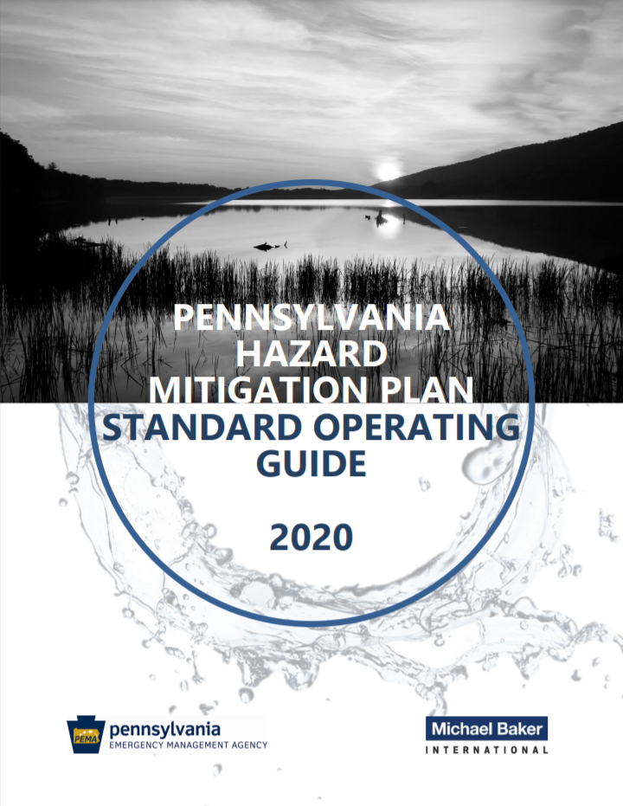
Pennsylvania Hazard Mitigation Plan Standard Operating Guide 2020
Consult Pennsylvania’s updated Standard Operating Guide:
Model HMP outline
Standard list of hazards
Risk factor methodology
Risk prioritization method
PA HMP Standard Operating Guide 2020

Slide 68


Silver Jacket Initiative Interagency Document
INTERAGENCY FLOOD MITIGATION PROGRAM GUIDE
Developed and finalized by our Pennsylvania team July 2011 – being used across the country now as a Best Practices Reference Document
http://www.portal.state.pa.us/portal/server.pt/community/programs_and_services/4547/hazard_mitigation_forms_presentations_and_other_documents/806856
PA Silver Jackets Program Guide_FINAL JUL 2011.pdf
http://www.WAB.USCAR.ARMY.MIC/SILVERJACKETS
Flood Risk Management Tool

Slide 69
Act 13 Programs
Marcellus Legacy Fund
Administered by DEP
Andrew Orlovsky aorlovsky@pa.gov (717) 787 6245
Abandoned Mine Drainage abatement and Treatment Program
Baseline Water Quality Data
Greenways, Trails and Recreation
Orphan Wells
Sewage Facilties
Watershed Restoration
https://dced.pa.gov/programs-funding/commonwealth-financing-authority-cfa/act-13-programs/

Slide 70
Dept of Conservation and Natural Resources (DCNR)
Grants Page: https://brcgrants.dcnr.pa.gov/
Rivers Conservation Grants
Land Acquisition and Conservation Funding
Community Recreation and Conservation Planning Funding
Master Site Development Plans
Park Rehabilitation and Development Funding
Riparian Forest Buffer Funding

