Slide 1
Cumberland County’s Action Plan

Slide 2
WIP Planning Process
6-8 month timeframe to prepare plan
Implementation begins
Plan is updated frequently
Progress is reported against 2025 targets

Slide 3
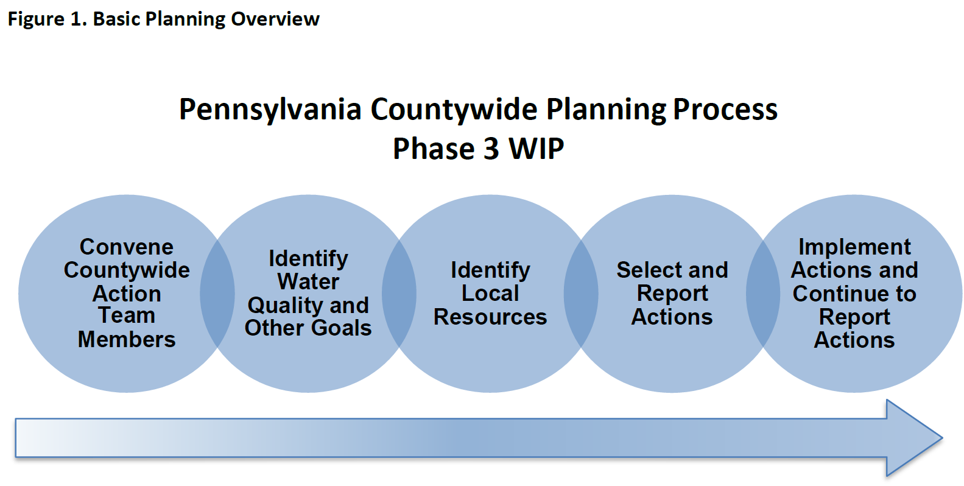

Slide 4
Why should I be involved?
Articulate what matters to you about clean water and learn about practical solutions
Leverage work your organization is already doing through partnerships/funding opportunities
Make policy/program recommendations to make your work more effective

Slide 5
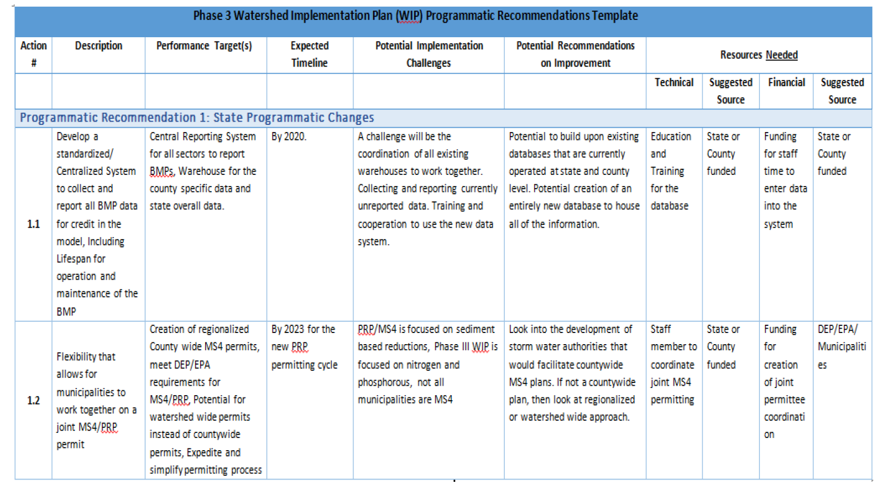
Programmatic Recommendations Template

Slide 6
What is needed from me?
Review materials prior to the next meeting
Consider your priorities and where they align
Join a committee and dig into the planning
Bring resources/challenges/recommendations to our attention

Slide 7
Next Steps in Planning Process
Cumberland County is contracting with a consultant to fill the role of WIP Coordinator
DEP will conduct coordinator training at the end of February
March meetings will be scheduled with agriculture and stormwater committees
Stakeholder group will convene again in April

Slide 8
Website for Countywide Action Plan updates:
https://www.ccpa.net/4775/Watershed-Implementation-Plan
Contact Cumberland County Planning Office:
Elizabeth Grant, AICP
egrant@ccpa.net
(717)-240-6377

